Slide 1

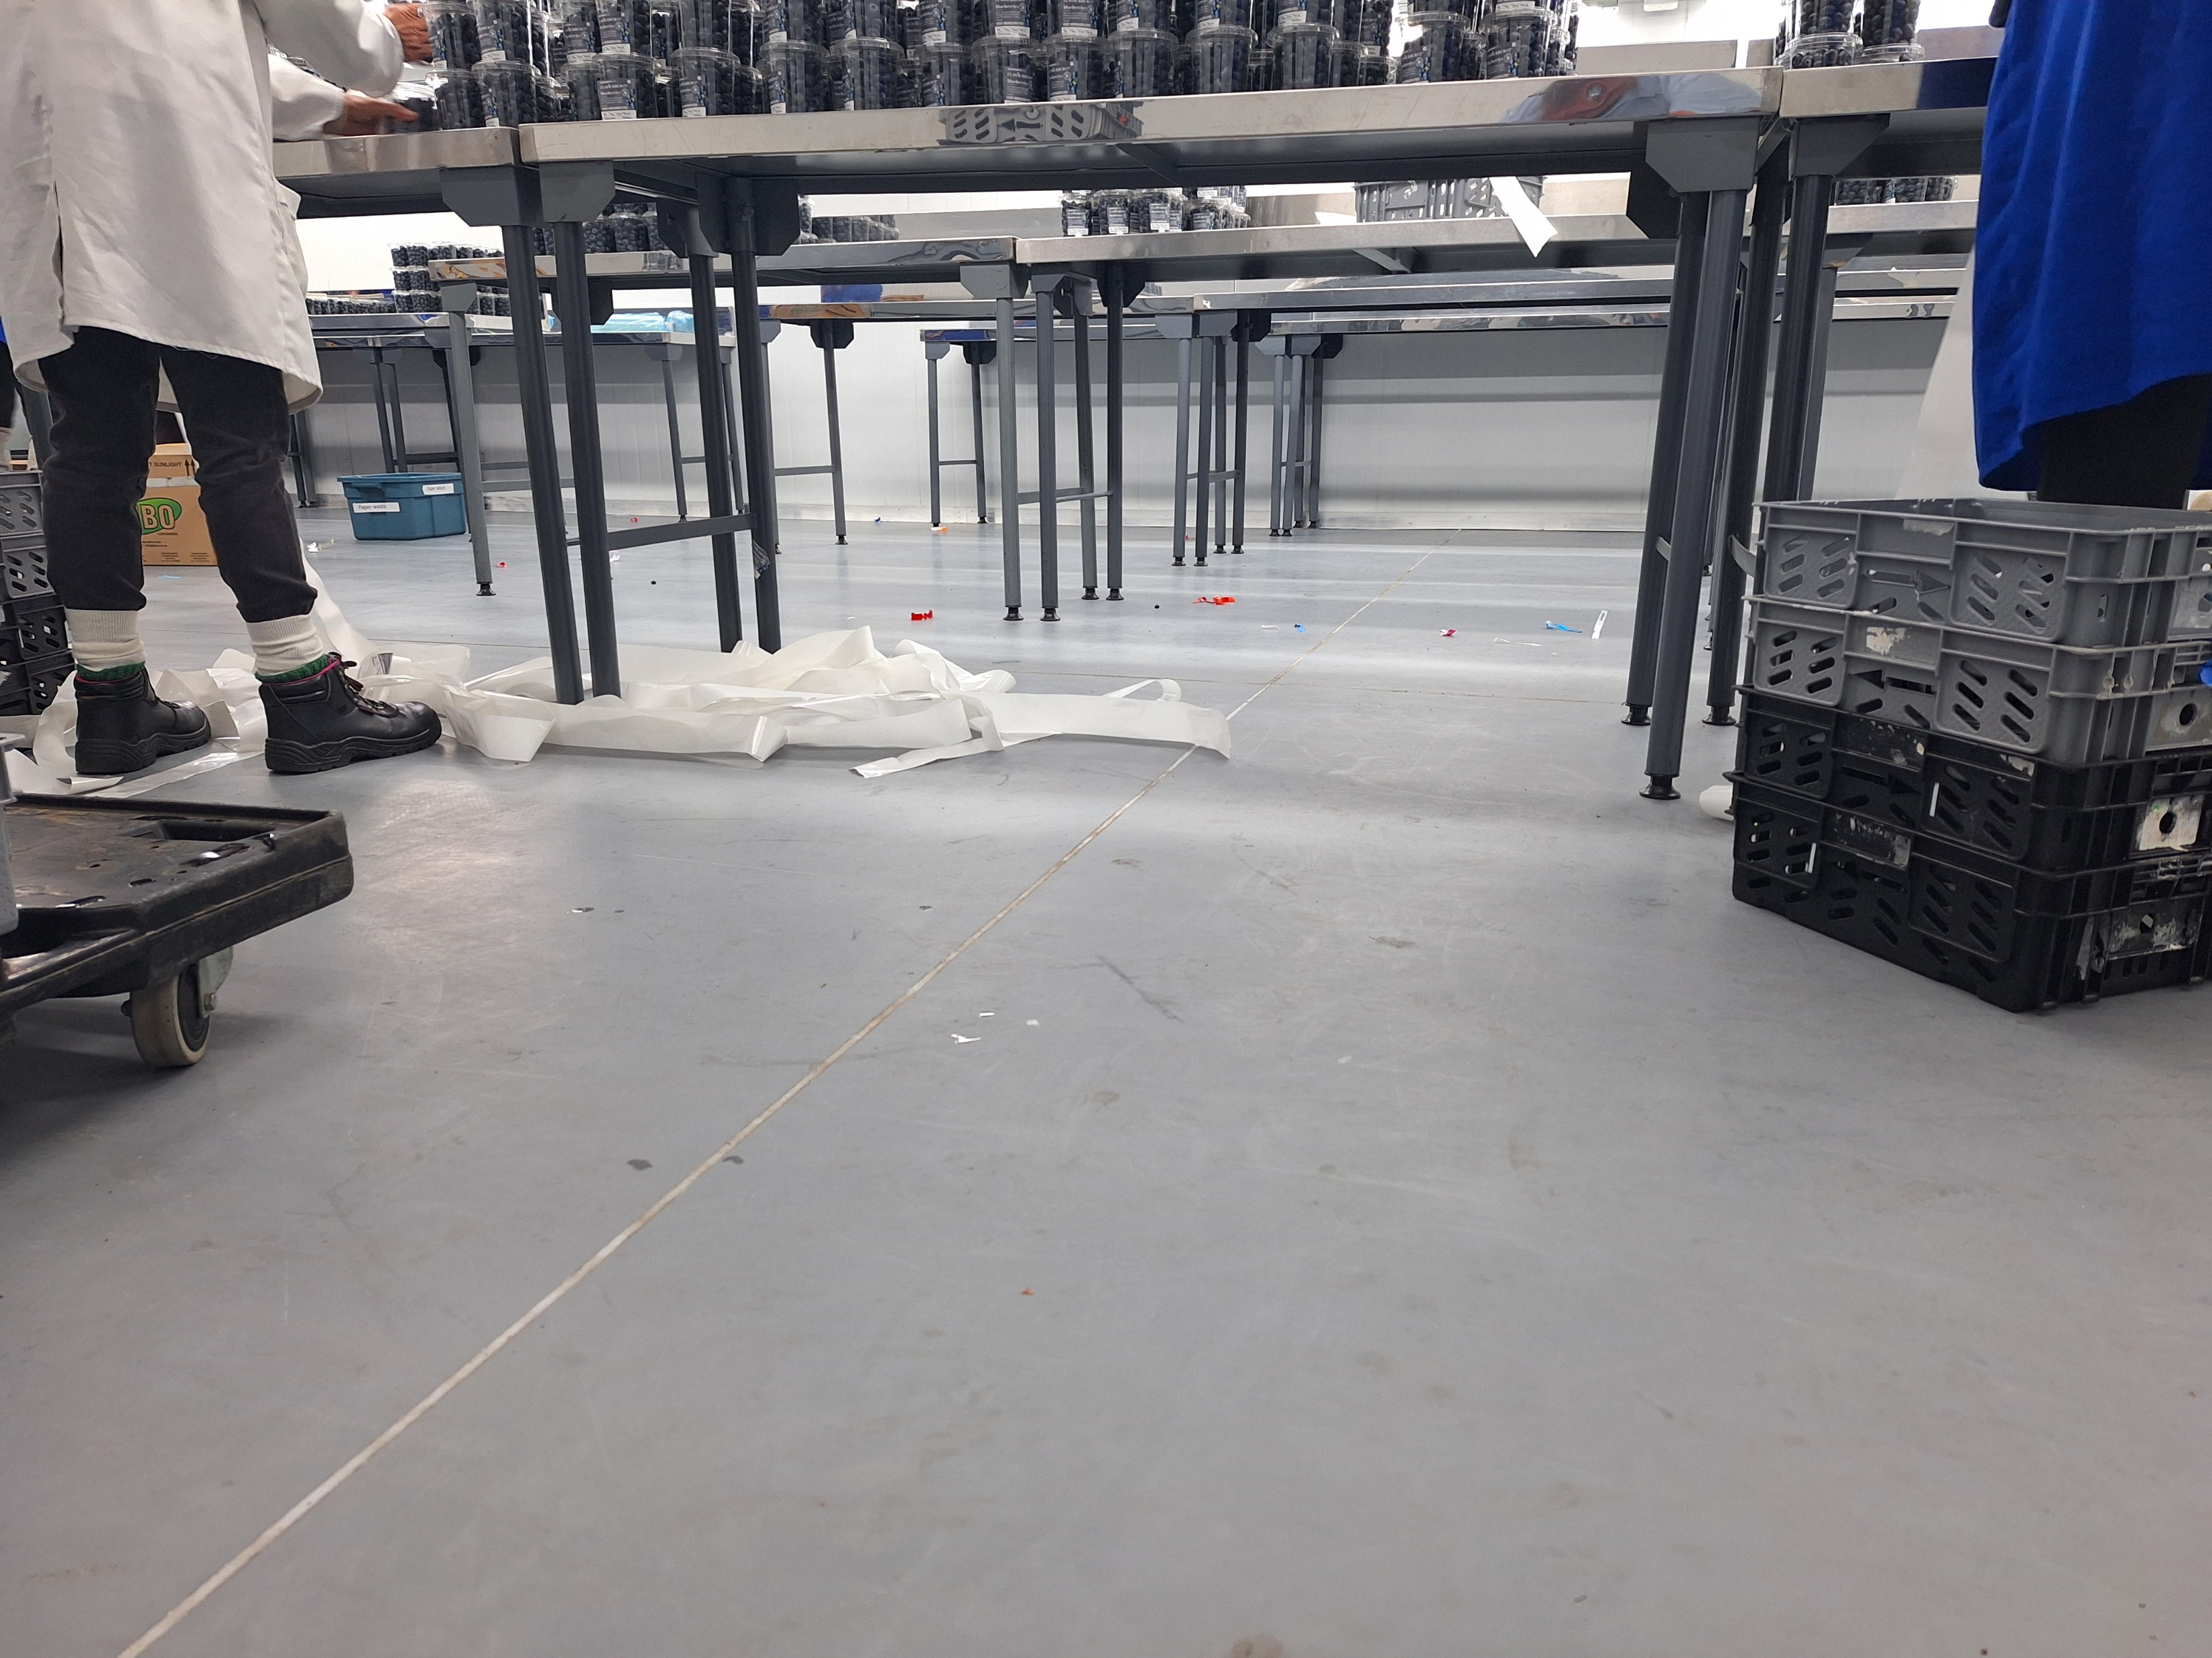


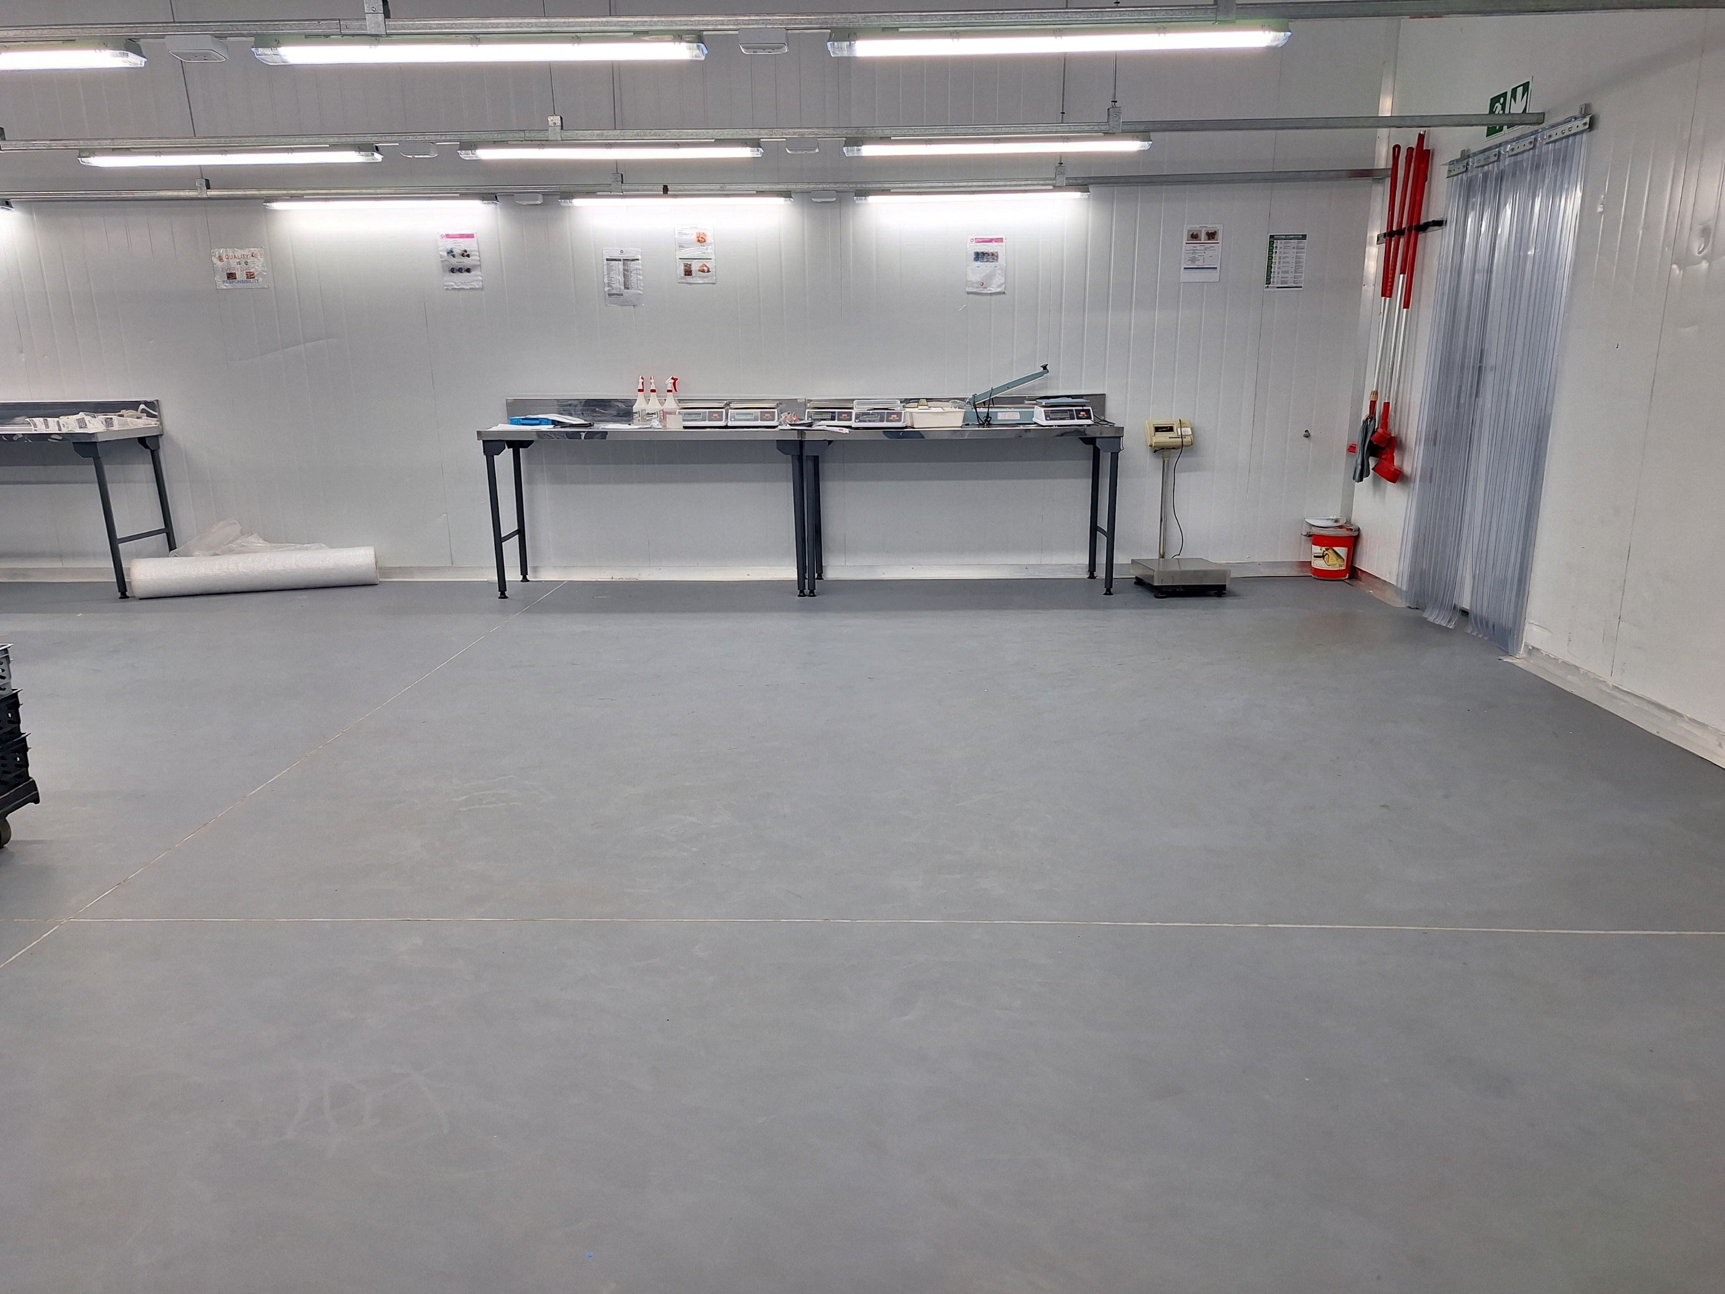
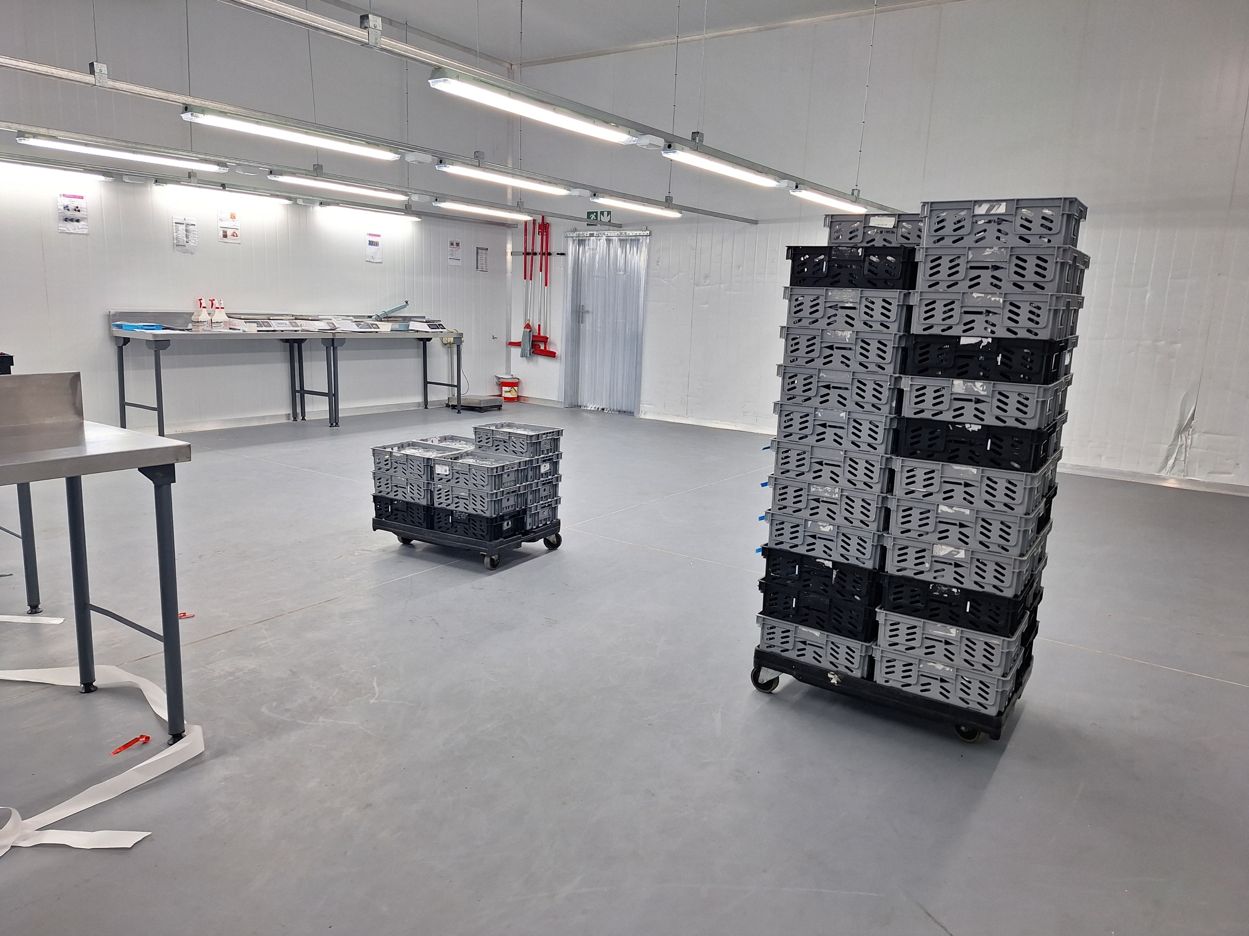
PROJECT SUMMARY
Polyscreed SL, a 2 to 3 mm self-levelling polyurethane flooring system, was selected for this project due to its suitability for the food processing environment. This system delivers a protective floor finish that is ideal for predominantly dry conditions. Polyscreed SL has a smooth, matt finish that facilitates easy cleaning and offers temperature resistance from -5 to 60ºC. The flooring system is designed for use in the food industry, providing resistance to fruit acids and cleaning chemicals. Our Polyscreed PU systems’ antimicrobial silver ion technology has been scientifically proven to inhibit bacterial growth by up to 99.9%.
After the existing substrate was thoroughly cleaned and prepared, the surface was primed with Polyscreed PU Primer and left to cure for 16 hours. Polyscreed SL was then applied at a thickness of 2 to 3 mm in accordance with the manufacturer’s instructions. All joints in the concrete substrate were seamlessly incorporated into the Polyscreed SL system and sealed with Solidjoint 525. The project was successfully completed in just five days.
MIDRAND
Fruit Packaging
Building Type | Commercial
Project Size | 360 m²
Build Dates | Completed May 2024
Contractor/Architect | Impophoma Projects
SAINT-GOBAIN MAIN PROJECT SOLUTIONS
A polyurethane
screed with
physical and
chemical
resistance, safe
for the food
industry
PROJECT CHALLENGES
Challenge 1 – Ensuring the existing substrate was properly prepared and thoroughly cleaned to remove any contaminants that could prevent the new polyurethane flooring system from adhering to the substrate.
Challenge 2 – Meeting the customer’s request for a smooth, non-slip, protective floor finish that is safe to be used in food processing areas. The floors also needed to withstand exposure to various chemicals, including organic acids from the fruit and cleaning agents used for maintenance.
Challenge 3 – Minimizing downtime to operations while ensuring a thorough installation of the new flooring system.
BETTER FOR
PEOPLE
BETTER FOR THE PLANET
SAINT-GOBAIN SOLUTIONS
INDUSTRY
Food & Beverage
Processing
PRODUCT LINKS
Click on the text hyperlinks
Polyscreed SL
Solidjoint 525
CONNECT WITH SAINT-GOBAIN
At Saint-Gobain, we strive to make the world a better home through building better for people and the planet.
For additional information about our diverse product offerings and solutions, we invite you to visit our websites: GYPROC, ISOVER, WEBER, ,a.b.e & Technical Finishes
saint-gobain.technical@saint-gobain.com

